Slide 1
CDS-492 Capstone in Data Science · Oral Presentation · Spring 2026
Identifying Undiagnosed Type 2 Diabetics
with CatBoost Modeling on One Million Korean Health Checkup Records
Tyson Johnson · Alizeh Murtaza · Nithila Neethi Devan · Tariq Abdulhak
Faculty Advisor: Dr. Mohamed Adel Slamani
George Mason University · College of Science · Team 3c
Notes:
Good morning. We're Team 3c, and our project is *Identifying Undiagnosed Type 2 Diabetics* using CatBoost modeling on one million Korean health checkup records. I'm Tyson Johnson, and I'm here with my teammates Alizeh Murtaza, Nithila Neethi Devan, and Tariq Abdulhak. Our advisor is Dr. Slamani.
Over the next ten minutes we'll walk you through why this problem matters, how we modeled it, what we found, and how it's deployed.

Slide 2
Why Type 2 Diabetes?
537 M
adults living with diabetes (IDF, 2022)
44.7 %
of all cases are undiagnosed
35–70
the only USPSTF age band screened, BMI-gated
Figure 1. Global burden of T2D and the narrow band currently covered by U.S. screening guidance.
Current screening tool
Type
What it misses
USPSTF 2021 guideline
BMI + age trigger
Metabolically unhealthy normal-weight patients
FINDRISC / IDRS / ADA
Questionnaire risk score
Limited sensitivity in diverse populations
Single-test clinical review
Manual
Multivariable nonlinear interactions across labs
Table 1. Existing screening approaches each leave a clinically important gap that motivates an ML-based screen.
Team 3c · CDS-492 Capstone · Spring 2026
2 / 16
Notes:
The motivation is stark. The International Diabetes Federation estimates that 537 million adults worldwide are living with diabetes, and 44.7 percent of those cases are undiagnosed. This matters since untreated type 2 diabetes can lead to serious complications such as cardiovascular disease, kidney failure, neuropathy, and retinopathy. So every year of a delayed diagnosis poses serious consequences.
Current screening guidelines also miss a lot of people. For example, the U.S. Preventive Services Task Force recommends screening only adults 35 to 70 with overweight or obesity. That can miss metabolically unhealthy patients who are not overweight. Questionnaire-risk scores like FINDRISC, IDRS, and ADA are helpful but show limited sensitivity outside the populations they were designed for.
But here's the thing: routine health checkups already collect the data we need. The question is whether machine learning can use it.

Slide 3
Proposed Solution
Routine NHIS checkups already collect the data — the question is whether ML can use it.
Aspect
Prior NHIS work
Our work
Model families compared
Deep learning only
8 models: trees, NNs, linear
Feature design
Fixed feature set
3-tier ablation (Core / +Labs / +Lipids)
Probability quality
Raw scores
Platt-calibrated, recall-targeted threshold
Missing-data handling
Imputation
Native CatBoost handling, no imputation
Output
Single binary score
FastAPI tool with 4-tier risk stratification
Table 2. Five gaps in prior NHIS-based diabetes ML work that this project closes — supporting evidence: Grinsztajn 2022 (NeurIPS) on tabular trees vs. deep learning.
Team 3c · CDS-492 Capstone · Spring 2026
3 / 16
Notes:
Clinicians reviewing labs in isolation miss the high-dimensional and nonlinear patterns that flag elevated risk. That is where machine learning can be help, especially sicne recent work shows tree-based models match or outperform deep learning on tabular health data.
Our oppourtunity came from Korea's National Health Insurance Service, or NHIS, which publishes about a million anonymized health-checkup records every year. This gave us one of the largest publicly available dataset to work with.
Prior NHIS work exists, but it mainly focused on deep learning with no comparison on controlled tree-versus-neural-networks . That's the gap we set out to close- run a comparison across model families on identical data splits, include calibration, and deployed an actual screening tool.

Slide 4
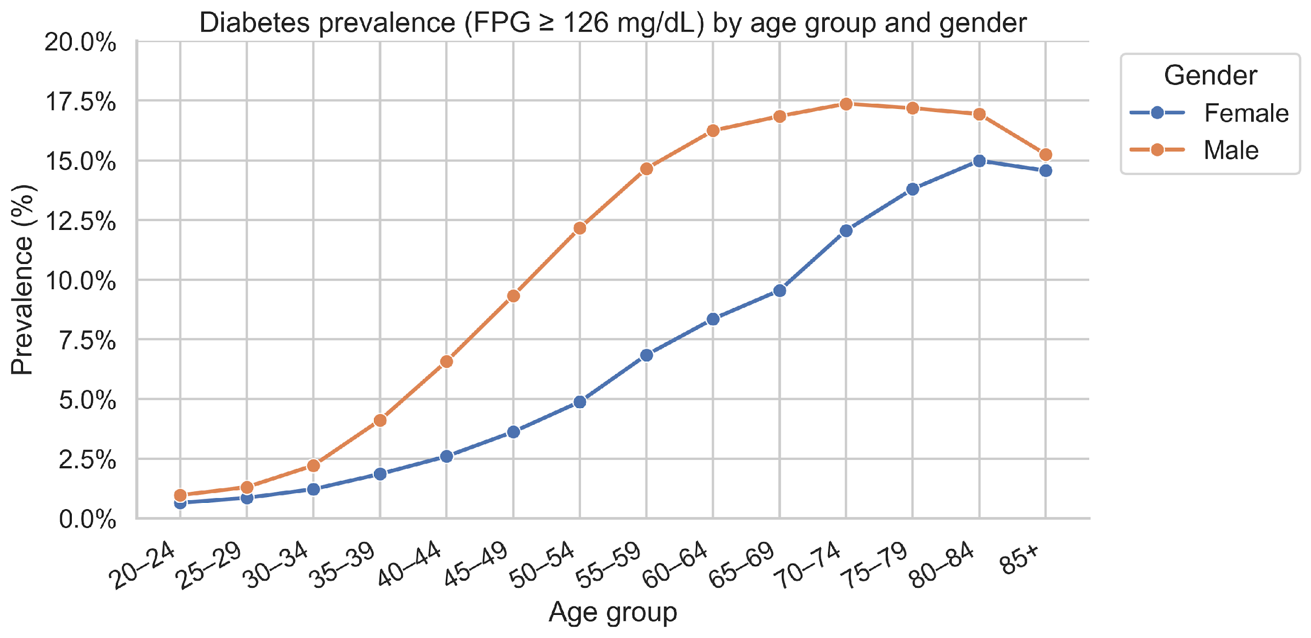
Data Overview
Field
Value
Source
2024 Korean NHIS, public
Records (validated)
994,147
Label
FPG ≥ 126 mg/dL (ADA)
Positive rate
7.9 %
FPG as input
Excluded (avoid leakage)
Figure 2. Diabetes prevalence rises sharply with age in both sexes; men cross 10% by age 50.
Split
60 / 20 / 20 stratified, seed 42
Table 3. Dataset composition and the design choice that prevents circular prediction.
994,147 NHIS records with a 7.9% diabetic-positive rate
Team 3c · CDS-492 Capstone · Spring 2026
4 / 16
Notes:
This slide introduces the dataset. We used the 2024 NHIS general health examination dataset. It is public, anonymized, and after domain validation we kept *994,147 records*.
We defined our label using fasting plasma glucose, or FPG, at or above 126 milligrams per deciliter, which is the ADA diagnostic threshold. About 7.9 percent of records cross that line. One critical design choice is that we *removed FPG itself from the model's inputs*, because the label is derived from FPG, and including it would trivialize the task.
The data was split 60, 20, 20,into training, validation, and test sets stratified by class, with a fixed seed of 42 to preserve class balance.
The chart on the right makes it concrete: diabetes prevalence rises sharply with age in both sexes, which is going to matter when we talk about feature importance.
With that, I'll pass it to Alizeh to walk through how we built the model.

Slide 5
Feature Engineering
Tier
Name
# Feats
What's added
Coverage
1
Core
15
Demographics, anthropometrics (BMI, WHtR, WWI), BP, urine protein
All examinees
2
Core + Labs
26
Adds hemoglobin, creatinine, log AST/ALT/GGT, AST/ALT ratio
All examinees
3
Full
40
Adds full lipid panel + ratios (TG/HDL, TC/HDL, LDL/HDL)
~34 % (lipids optional)
Table 4. Each tier strictly contains the previous one — the design enables a clean ablation of the marginal value of each data category.
Why nested?
~66% of NHIS records lack a lipid panel because the test is optional. Nested tiers let us measure exactly how much each data category buys us — and confirm the model degrades gracefully without lipids.
Team 3c · CDS-492 Capstone · Spring 2026
5 / 16
Notes:
Thanks, Tyson. Our feature engineering is organized as three nested tiers, mirroring what NHIS actually collects in practice.
Tier 1 is the core tier, 15 features. This includes demographics, anthropometrics like BMI, waist-to-height ratio and weight-adjusted waist index, plus blood pressure and urine protein. These are available for every NHIS examinee.
Tier 2 is Core plus Labs, with 26 features. This adds hemoglobin, creatinine, log-transformed liver enzymes like AST, ALT, GGT, and the AST-to-ALT ratio.
Tier 3 is the Full tier, with 40 features. This adds the full lipid panel including cholesterol, HDL, LDL, log triglycerides, and three derived ratios.
We used a nested design because about 66 percent of NHIS records lack a lipid panel, because the test is optional. The tiered design lets us measure exactly how much each data category buys us — a clean ablation of marginal value, which becomes one of our key results.

Slide 6
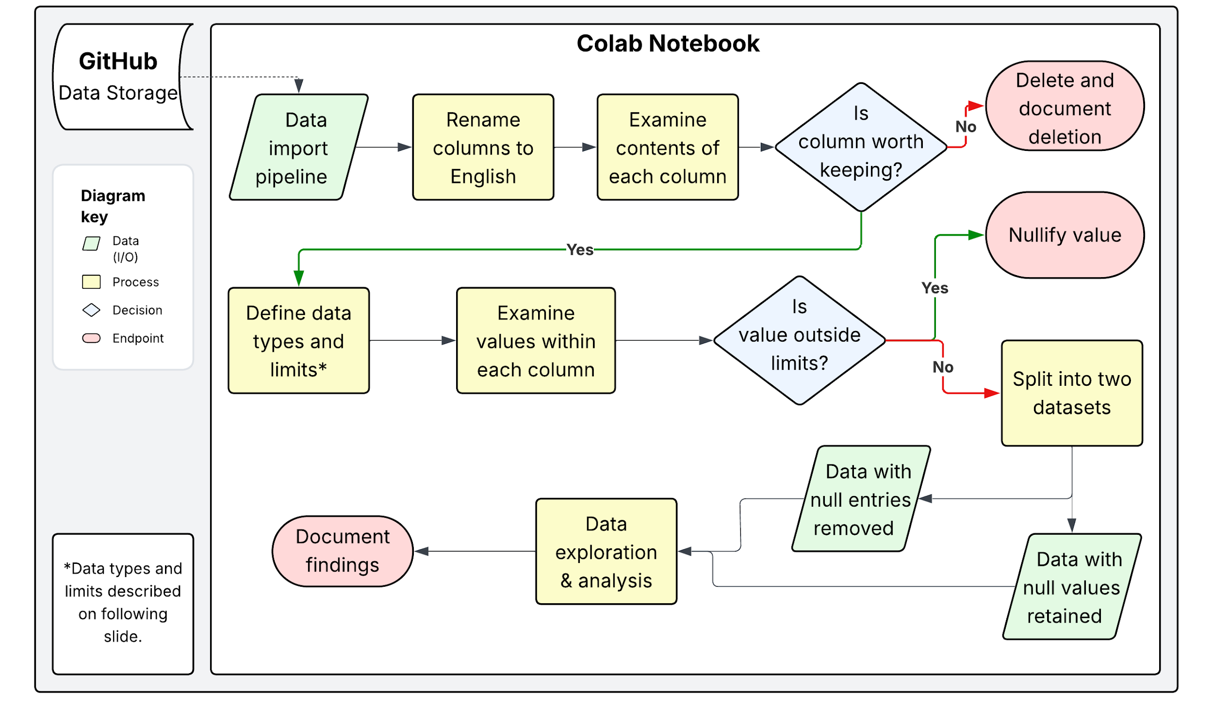
Project Data Preparation
Figure 3. Four-stage preprocessing pipeline: domain validation → log transforms (AST, ALT, GGT, TG) → age-band midpoint encoding → stratified 60/20/20 split. No imputation — missingness is preserved natively for CatBoost.
Team 3c · CDS-492 Capstone · Spring 2026
6 / 16
Notes:
The preprocessing pipeline is four stages. First, we applied domain validation and set out-of-range values to missing, or NaN. This prevents extreme outliers from distorting feature engineering. Second, we log transformed variables right-skewed variables like liver enzymes and triglycerides. Third, age encoding converted the NHIS five-year band code into a continuous midpoint. And finally, we created a stratified 60-20-20 split.
Critically, we do not impute missing values for CatBoost. CatBoost handles missingness natively, and we'll see in the results why that turned out to be the right call.

Slide 7
Model Comparison
Family
Model
Imbalance handling
# Feats
Notes
Tree
CatBoost (Core)
Inverse-freq weights
15
Ablation tier
Tree
CatBoost (Core + Labs)
Inverse-freq weights
26
Ablation tier
Tree
CatBoost (Full)
Inverse-freq weights
40
Production model
Tree
Decision Tree
Inverse-freq weights
40
Tree baseline
Neural
PyTorch Tabular Net
Inverse-freq weights
40
Learned cat embeddings
Neural
sklearn MLP
Minority upsample 30 %
40
Wide-net baseline
Linear
Logistic Regression
Inverse-freq weights
40
Linear baseline
Linear
Linear SVC
Inverse-freq weights
40
Margin baseline
Table 5. All eight models share the same 60/20/20 stratified splits (seed 42); only architecture and feature set vary.
Why ROC-AUC: threshold-independent and stays informative under our 1:11.7 class imbalance.
Team 3c · CDS-492 Capstone · Spring 2026
7 / 16
Notes:
We trained eight models on identical splits to make the comparison fair. These came from three model families.
For tree models, we used CatBoost in three feature-set configurations, Core, Core-plus-Labs, and Full, with a Decision Tree baseline. For neural networks, a PyTorch tabular network with learned categorical embeddings, and a scikit-learn MLP was used. For linear baselines, we used logistic regression and a linear SVM.
Class imbalance is handled with inverse-frequency weighting on most models, and minority upsampling for the MLP.
The primary metric was ROC-AUC, because it's threshold-independent and stays informative under our roughly twelve-to-one class imbalance.

Slide 8
Selected Model: CatBoost
Parameter
Value
Rationale
Production model
Test ROC-AUC 0.817
Sensitivity 85.2 %
NPV 98.0 %
Brier score 0.064
Threshold 0.0659
Loss
Logloss
Binary classification
Depth
6
Balance bias / variance
Learning rate
0.03
Slow, steady convergence
L2 regularization
5.0
Reduce overfit on imbalanced data
Max iterations
1,500
Headroom for early stopping
Early stop
100 rounds
Stop on validation plateau
Best iteration
1,324
Selected by early stopping
Table 6. Production CatBoost hyperparameters tuned on the validation set.
Ordered boosting + native categorical handling
SHAP — defensible for clinical audit
Native missing-value handling; no imputation pipeline at inference
Team 3c · CDS-492 Capstone · Spring 2026
8 / 16
Notes:
CatBoost ended up as our production model for three reasons.
One, using ordered boosting and native categorical handling, so no manual one-hot encoding, no target leakage. Two, it gives us exact TreeSHAP values — not the approximate values from model-agnostic methods. That matters for clinical adoption, because the SHAP rankings have to be defensible. Three, it handles native missing-value handling — no imputation pipeline at inference time — and substantially faster training and inference than the neural alternatives.
Hyperparameters are on the slide: depth 6, learning rate 0.03, L2 of 5.0, up to 1,500 iterations with early stopping. The best iteration was 1,324.
The panel on the right is a previews the main outcome: test ROC-AUC of 0.817, sensitivity 85 percent, NPV 98 percent. With that, I'll hand it to Nithila to walk through what we found.

Slide 9
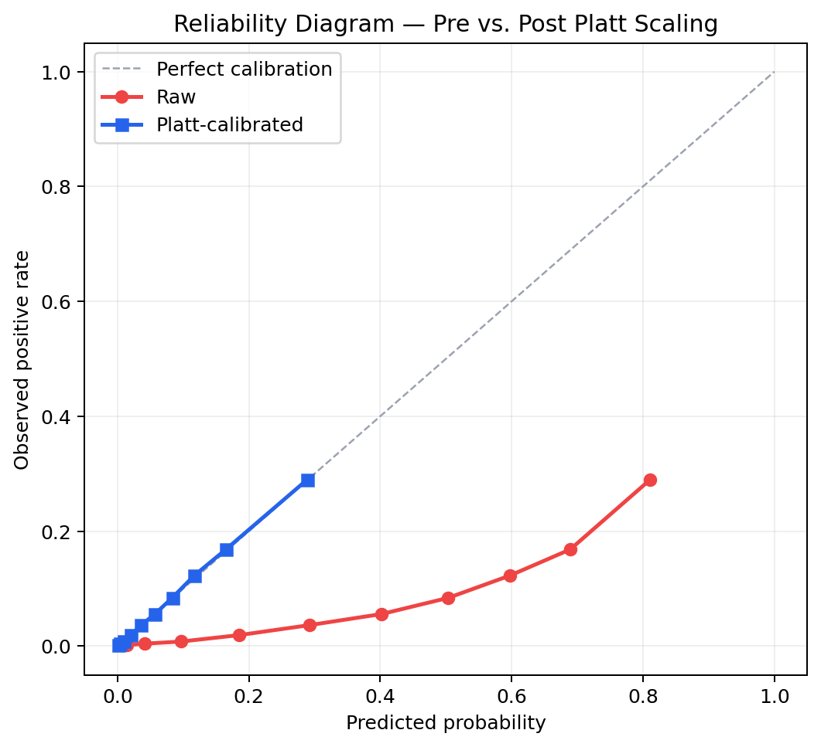
Probability Calibration & Threshold
Step
Detail
Calibrator
Platt scaling, fit on val set
Equation
σ(a · logit p̂ + b)
Property
Monotonic — leaves AUC unchanged
Threshold rule
Lowest p with ≥85 % recall (val)
Operating p
0.0659
Cost asymmetry
FN ≫ FP in screening
Table 7. Calibration and operating-point selection deliberately trade specificity for sensitivity.
Figure 4. Reliability curves before and after Platt scaling. Post-calibration probabilities track the diagonal; Brier 0.064.
Team 3c · CDS-492 Capstone · Spring 2026
9 / 16
Notes:
Thanks, Alizeh. Two things had to be done before we could talk about clinical performance: calibration and threshold selection.
Raw boosting probabilities are poorly calibrated — a predicted 10 percent doesn't actually correspond to a true 10 percent prevalence. So we applied Platt scaling on the validation set. Because it's monotonic, it leaves ROC-AUC unchanged but pulls the reliability curve onto the diagonal.
For the threshold, we made an explicit screening choice: a false negative is much costlier than a false positive. We picked the lowest probability that achieves at least 85 percent sensitivity on validation — that landed at 0.0659.
The plot on the right shows pre- and post-calibration. The post-calibration curve hugs the diagonal, and Brier score drops to 0.064.

Slide 10
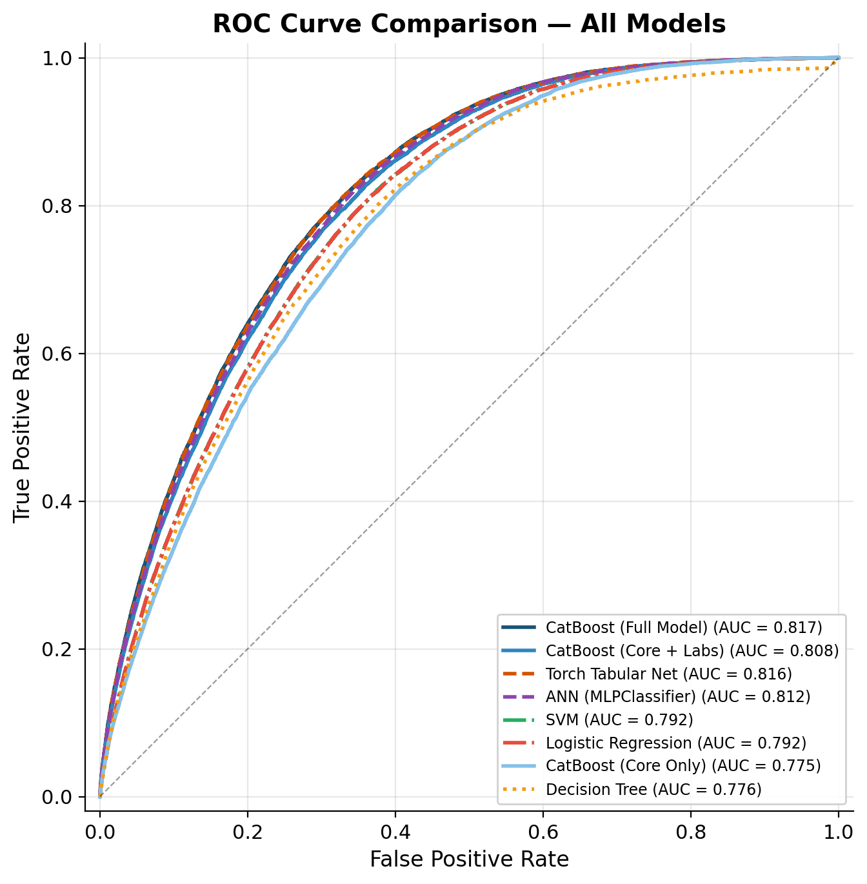
ROC Curve Comparison
Model
AUC
CatBoost (Full)
0.817
PyTorch Tabular Net
0.816
sklearn ANN / MLP
0.812
CatBoost (Core+Labs)
0.808
Logistic Regression
0.792
Linear SVC
0.792
Decision Tree
0.776
CatBoost (Core only)
0.775
Table 8. Top three models within 0.005 AUC despite different architectures — trees match deep nets on tabular health data.
Figure 5. ROC curves for all eight models on the held-out test set (n = 198,830).
Team 3c · CDS-492 Capstone · Spring 2026
10 / 16
Notes:
Here's the headline result. CatBoost on the full 40-feature set hits 0.817 ROC-AUC on the held-out test set.
PyTorch Tabular Net is at 0.816, the sklearn MLP is at 0.812. The top three models are within 0.005 AUC of each other, despite fundamentally different architectures. That's consistent with the broader finding from Grinsztajn at NeurIPS that tree models match or beat deep learning on tabular data.
The linear baselines — logistic regression and linear SVM — both come in at 0.792, and the single decision tree at 0.776. So neural depth isn't doing extra work here.
We picked CatBoost over the neural alternatives for the reasons Alizeh covered: exact SHAP, native missingness, faster inference.

Slide 11
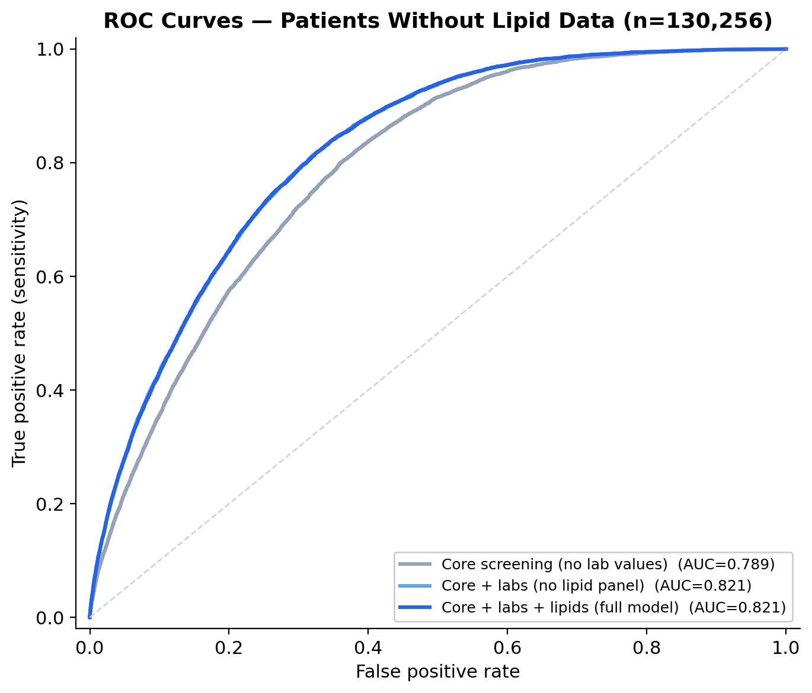
ROC Curve Comparison (Non-Lipid Subset)
Feature set
# Feats
AUC
Δ AUC
Core
15
0.789
—
+ Labs
26
0.821
+0.033
+ Lipids
40
0.821
+0.000
Table 9. AUC contribution of each tier; lab tests deliver the lion's share.
AUC 0.821
on the 130 k test patients lacking lipids
Figure 6. ROC curves for the three CatBoost feature-set tiers on the test set.
Team 3c · CDS-492 Capstone · Spring 2026
11 / 16
Notes:
This was one of our most useful findings. We trained CatBoost on each tier with identical hyperparameters.
The core alone hits 0.775. Adding the six routine lab values- hemoglobin, creatinine, the liver enzymes — jumps us to 0.808, a gain of 0.033. Adding the entire lipid panel only adds another 0.009, taking us to 0.817.
We also found on the 130,000 test patients who lack lipid data, the model still gets an AUC of 0.821. The model degrades gracefully when lipids are missing. The policy implication is real: cholesterol tests are not required for effective screening.

Slide 12
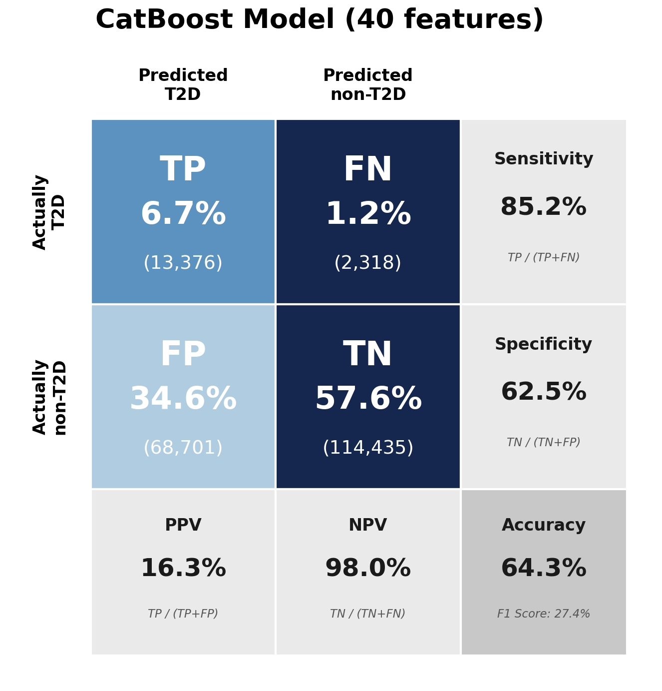
CatBoost: Confusion Matrix
Metric
Value
Interpretation
Sensitivity
85.2 %
Catches diabetic patients
NPV
98.0 %
Negative ⇒ rules out T2D
Specificity
62.5 %
Cleared truly-negative cases
PPV
16.3 %
Flagged ⇒ confirmatory test
Table 10. Recall-targeted operating point: a negative screen is trustworthy; a positive screen prompts a follow-up FPG test.
Cost of a mistake:
FP → one routine blood test
FN → disease goes untreated
Figure 7. Confusion matrix on the held-out test set (n = 198,830) at the operating threshold of 0.0659.
Team 3c · CDS-492 Capstone · Spring 2026
12 / 16
Notes:
At our screening threshold, the production model catches 85.2 percent of diabetic patients — 13,376 out of 15,694 — and a negative result rules out diabetes with 98 percent confidence.
Specificity is 62.5 percent, PPV is 16.3 percent. We're deliberately trading specificity for sensitivity, because in screening a false positive costs one follow-up blood test and a false negative leaves disease undetected.
So with that, I'll pass it to Tariq for what those results mean and where the tool goes from here.

Slide 13
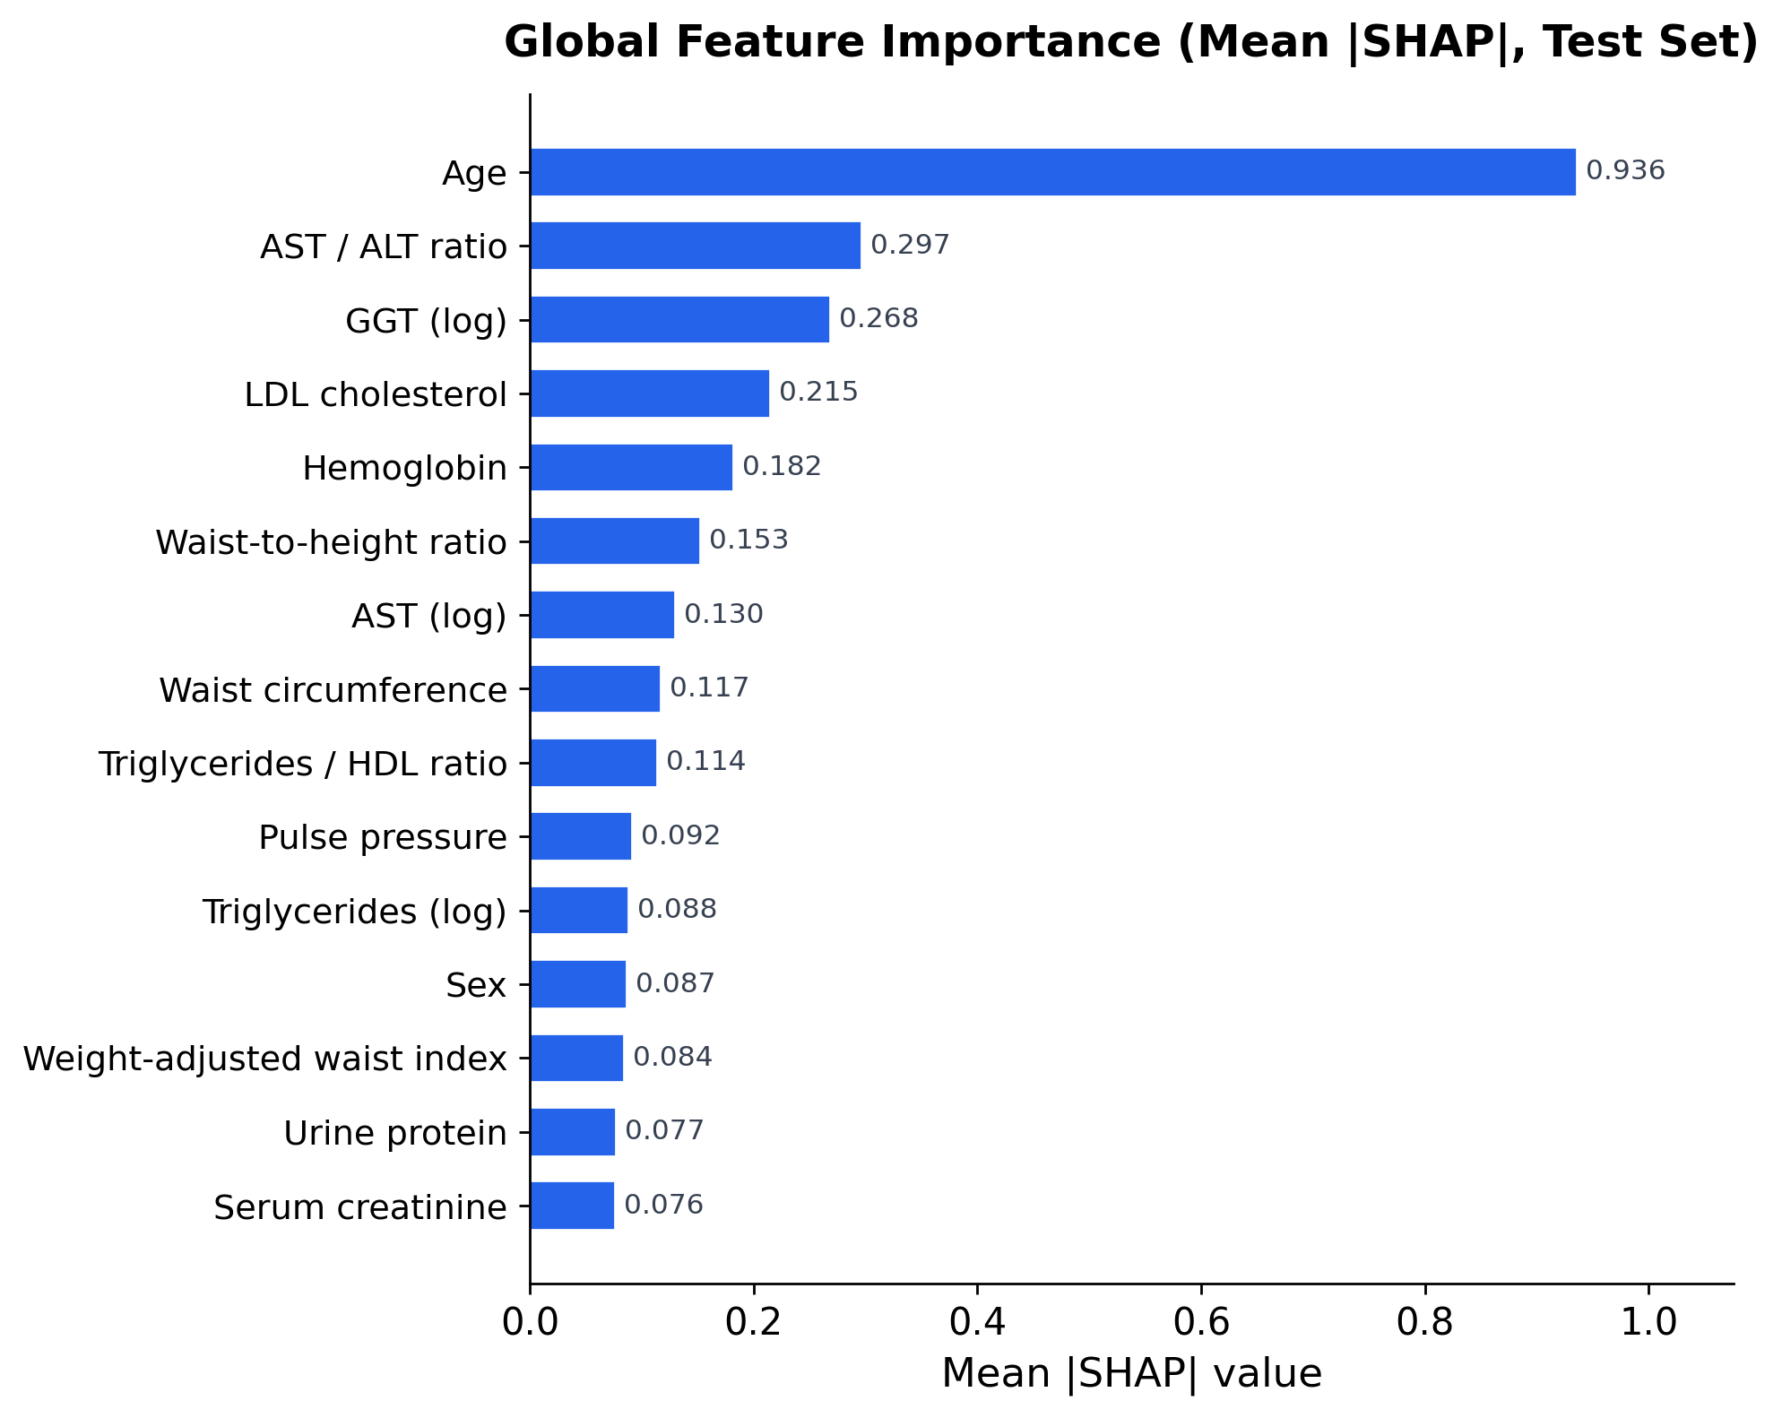
Shapley Value
#
Feature
Mean |SHAP|
1
Age
0.936
2
AST/ALT ratio
0.297
3
log GGT
0.268
4
LDL cholesterol
0.215
5
Hemoglobin
0.182
6
Waist-to-height
0.153
7
log AST
0.130
8
Waist circumference
0.117
9
TG/HDL ratio
0.114
10
Pulse pressure
0.092
Table 11. All top features are established T2D risk factors.
Figure 8. Mean |SHAP| of top features, exact SHAP on a 5,000-patient test-set sample.
Team 3c · CDS-492 Capstone · Spring 2026
13 / 16
Notes:
Thanks, Nithila. To be useful in a clinic, the model has to be interprettble, as clinicians need to see why it made a prediction. We used SHAP, computed exactly with SHAP, on a 5,000-patient sample to see which features were driving predictions.
Age was by far the strongest feature, with a mean absolute SHAP of 0.94- this is three times the runner-up. After that, the top features include AST/ALT ratio, log GGT, LDL, hemoglobin, waist-to-height ratio, and log AST. Every one of those is an established T2D risk factor. That alignment with clinical priors is reassuring that the model is learning real pathophysiology, not dataset artifacts.
One side note: all nine of our missingness-indicator flags came out at essentially zero SHAP. That suggests CatBoost's native handling of missing values is already capturing that information effectively.

Slide 14
Screening Tool Deployment
Layer
Implementation
Very High
Likely, recommend to see physician as soon as possible for testing
Backend
FastAPI service, calibrated CatBoost + Platt
Frontend
Vanilla-JS, lightweight clinic-friendly form
High
Reasonably likely, recommend to follow up with physician
Inputs
Partial fields accepted (native missingness)
Output
Calibrated probability + risk tier + caveat note
Moderate
Unlikely, but possible to have T2D; recommend to follow up with physician
Audience
Physicians and community health workers
Table 12. End-to-end deployment stack.
Low
Very unlikely to have T2D
Tier
Quantile
Calibrated probability
Low
0–p50
[0.000, 0.046]
Moderate
p50–p80
(0.046, 0.138]
Figure 9. Risk tiers and their corresponding recommendations based on likelihood of having T2D (as predicted by CatBoost model).
High
p80–p95
(0.138, 0.261]
Very High
p95+
(0.261, 1.000]
Table 13. Tier boundaries derived from test-set quantiles of the calibrated probability.
Team 3c · CDS-492 Capstone · Spring 2026
14 / 16
Notes:
We also wanted to show how this could work as an actual screening tool rather than just a model in a notebook. So we built an end-to-end web tool.
The backend is a FastAPI service that serves the calibrated CatBoost model, and the frontend is a lightweight JavaScript interface designed for clinicians or community health workers. Users can enter whatever fields they have available, and the tool returns a calibrated probability along with a risk tier.Partial inputs are fine, because CatBoost handles missing fields natively.
Rather than a single binary classification, we split the calibrated probability distribution by test-set quantile into four tiers:
Low — below the median, p in [0, 0.046] — routine recheck.
Moderate — p50 to p80, up to 0.138 — lifestyle counseling.
High — p80 to p95, up to 0.261 — schedule a follow-up.
Very High — top 5 percent, above 0.261 — prompt confirmatory blood test.
That gives the clinician an actionable output — not just a number.

Slide 15
Limitations & Potential Solutions
Limitation
Possible future work
Korean-only training cohort
Multi-cohort external validation (Japan, UK, US datasets)
FPG-only proxy label
Add HbA1c when available; treat known-T2D records separately
Cross-sectional, not predictive of incident T2D
Train on longitudinal NHIS records for incident-risk modeling
Single seed (42); no significance testing
Repeated random splits + bootstrap confidence intervals
No subgroup analysis (age / sex / BMI)
Stratified evaluation to confirm equity across subpopulations
37.5 % FP rate at chosen threshold
Regional threshold tuning to local prevalence
Selection bias in no-lipid subgroup
Calibrate confidence note when key labs are absent
Table 14. Known limitations of this work and the possible future work that addresses each one.
Team 3c · CDS-492 Capstone · Spring 2026
15 / 16
Notes:
We also want to be clear about the limitations of this work.
First, the model was trained only on Korean NHIS data, so outside populations still need external validation. Second, the label was based on a single FPG threshold rather than a confirmed diagnosis, so there is some unavoidable label noise. Third, this is a cross-sectional study, so it identifies likely current undiagnosed diabetes rather than future incident diabetes risk.
We also used a single random seed, did not run significance testing, and have not yet completed subgroup fairness analysis by age, sex, or BMI.
The next steps would be external validation across multiple cohorts, longitudinal modeling, subgroup analysis, and regional threshold tuning based on local prevalence and screening goals.”

Slide 16
Takeaways
0.817
Test ROC-AUC
85.2 %
Sensitivity at op. thresh.
98.0 %
Negative predictive value
1 M
Records, single seed
Figure 10. Headline performance summary on the held-out test set (n = 198,830).
• CatBoost matches deep learning on tabular health data — without an imputation pipeline
• Lipid panel is optional: Core + Labs already reaches 0.808 AUC
• SHAP rankings align with established clinical risk factors → clinician trust
• Deployed FastAPI tool maps calibrated p to four clinically meaningful tiers
Thank you · Questions?
Team 3c · Tyson Johnson, Alizeh Murtaza, Nithila Neethi Devan, Tariq Abdulhak
Team 3c · CDS-492 Capstone · Spring 2026
16 / 16
Notes:
To wrap up, our project shows that CatBoost can effectively identify undiagnosed type 2 diabetes risk using routine health checkup data at large scale.
Our final CatBoost model reached a test ROC-AUC of 0.817, matched deep learning performance, achieved about 85 percent sensitivity at the screening threshold, and produced a 98 percent negative predictive value. The lipid panel is helpful but not essential, as Core-plus-Labs performs strongly with 0.808 AUC. SHAP rankings line up with established clinical risk factors, and we have a deployed tool that turns the calibrated probability into four interpretable risk tiers.
Thank you — we'd be happy to take your questions.

